Slide 1
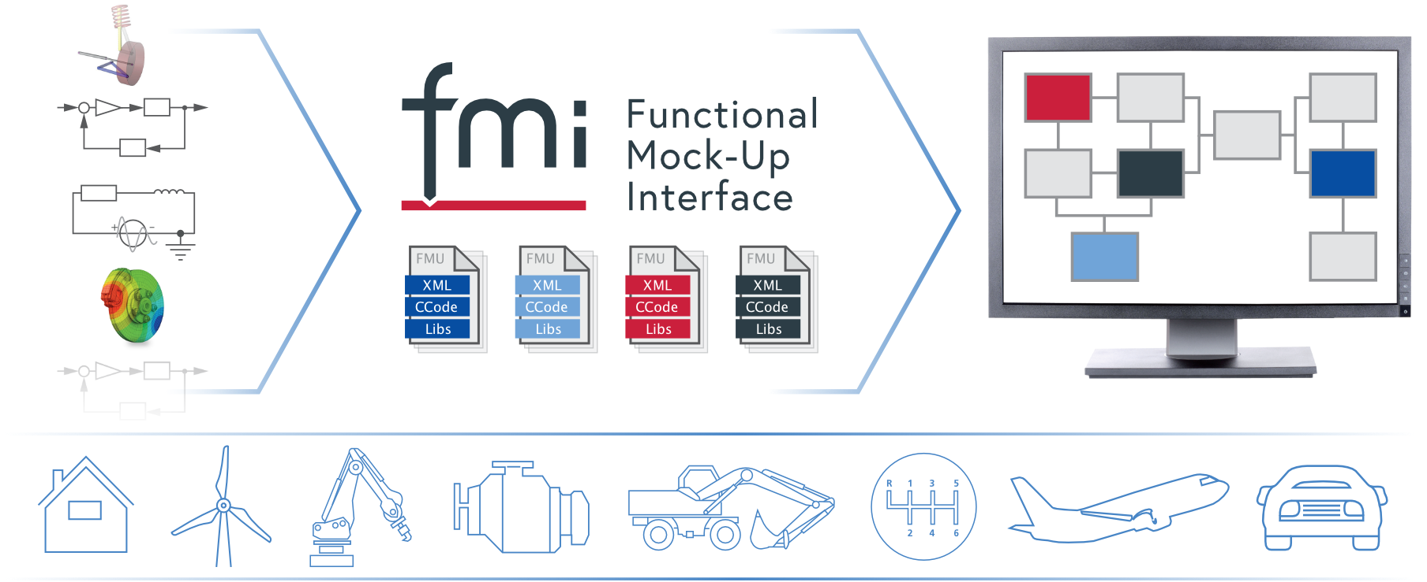
The Functional Mock-up Interface 3.0 Beginners’ Tutorial

Slide 2
Motivation, History, Organizational & Legal Aspects of FMI

Slide 3




































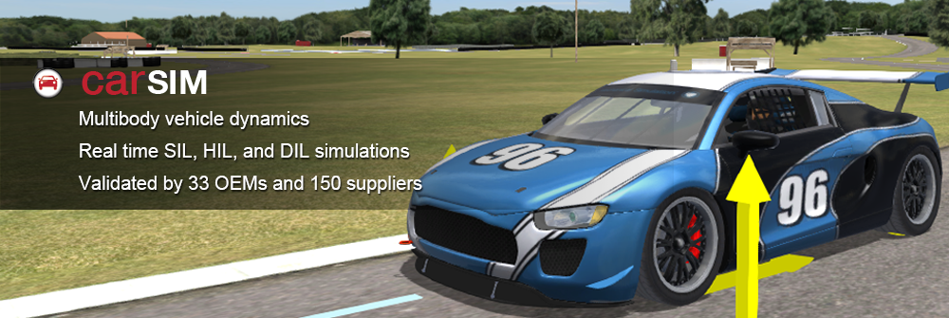















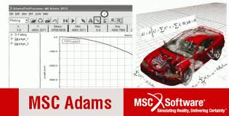









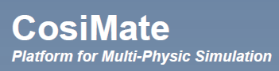








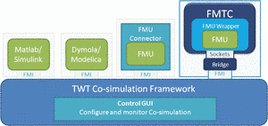



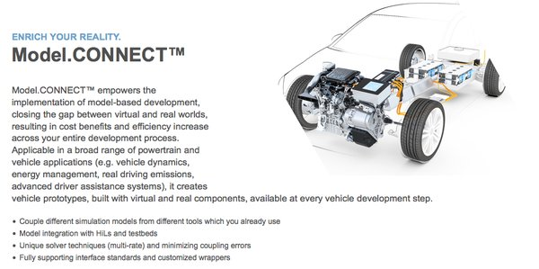


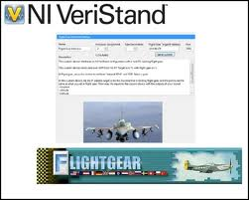



Fundamental idea
Simplorer
Cruise
ASCMO
develop model / code somewhere
FMU SDK
export as Functional Mockup Unit (FMU) by adding the FMI
FMU
import FMU
Simplorer
(co-)simulate model / run code somewhere else
INCA Flow
ModelFit
By TLK
COSYM
TLK TISC
VEOS
Silver
CarMaker®
The FMI standard decouples authoring and execution tool / toolchain / environment

Slide 4
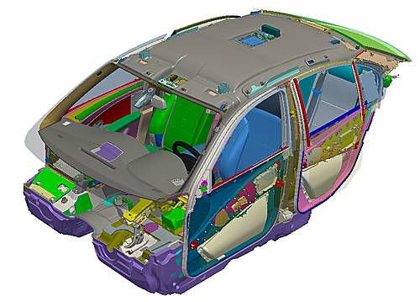
Motivation
Digital Mock-up (DMU) for packaging is state of the art in industry:
Suppliers deliver geometry of their components as CAD data
OEMs assemble them to the whole virtual system
Added value:
Check consistency of parts
Computation of design envelope
Evaluation of assemblability and disassemblability
How to include behavior in mockup?
Source: Teraport GmbH

Slide 5
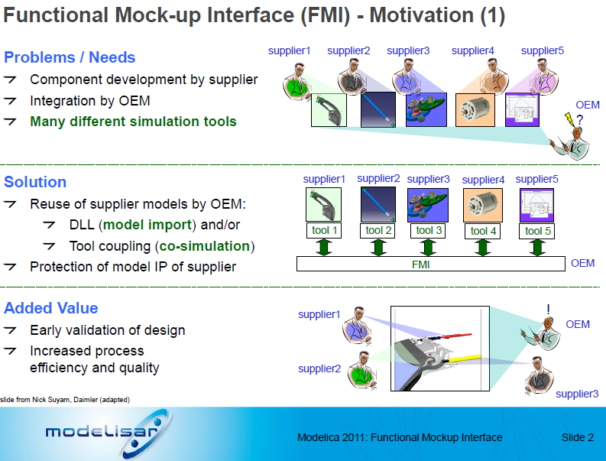
History
The FMI 1.0 was developed in 2008-2011 by initiative of DAIMLER in the EU-0funded MODELISAR project with participation of OEMs, tool vendors and research institutes.
FMI defines an interface for the model exchange between different simulation tools and development partners (e.g., OEMs <-> supplier)

Slide 6

Modelica Association & Tool Vendors
Modelica Association Project
FMI Design Group Members
All members have signed the MAP FMI’s CCLA (corporate contributor license agreement)
FMI Standard
FMI specifications: CC-BY-SA 4.0 (Creative Common Attribution-ShareAlike 4.0 International)
Source code (C-header & XML-schema files): 2-Clause BSD License7
Layered Standards
(domain specific extensions ot the FMI Standard)
Tool Vendors
have freedom to choose their licensing model
FMU import / export might be free
FMU export might require a license (e.g. Dymola)
FMU might require runtime license (FlexLMSee also
License conditions and legal aspects
Layered Standards
(domain specific extensions ot the FMI Standard

Slide 7
FMI technology

Slide 8
The FMI standard
The FMI Standard defines the “Functional Mock-up Interface” FMI, an interface between a model and a simulation environment.
It consists of
a C-API (application programming interface)
an interface description (modeldescription.xml) according to a defined schema
the definition of an exchangealble unit, an “FMU” (Functional Mock-up Unit), technically a zip file

Slide 9
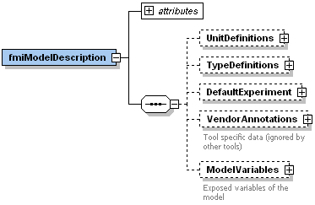
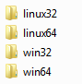
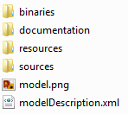
FMU Structure and Content
FMU implements FMI
FMU = .zip-file with renamed file extension
Must include modelDescription.xml (I/O description + some info)
Must include at least one binary representation or source code
Some optional content:
XML schema (.xsd)
defined by the
FMI specification
GUI
<<read>>
<<references>>
<<control>>
.fmu
Solver
1..*
model.dll
modelDescription.xml
<<run>>
Functional Mock-up Unit

Slide 10
(Co-)Simulation of multiple FMUs
Tool X
Tool Y
Tool Z
Tool n
FMU
FMU
FMU
FMU
…
Functional Mock-up Interface
Numerical Solver or Master Algorithm
Not defined by FMI!

Slide 11


FMU for Model Exchange vs. Co-Simulation
Model Exchange (ME)
Importing tool provides the solver.
Pros:
Typically more stable as the solver gets direct access to the entire set of equations (internal modules and FMUs).
Cons:
Importing tool must have rich set of solvers that are able to properly handle the imported FMU (stiff, variable step size, event handling, parse,…).
Co-Simulation (CS)
Exporting tool provides the solver.
Pros:
Exporting tool can apply the most appropriate solver.
Typically faster for large systems.
Well suited for parallelization and multi-rate integration.
Cons:
Numerical stability cannot be guaranteed.
Performance depends on master algorithm (communication step size, events, interpolation).
Master algorithm depends on the maturity of the FMUs.
FMU
Tool
FMU
Tool
Model
Solver
Model
Solver

Slide 12
FMI for Co-simulation Tool Wrapper Variant
Co-simulation stand-alone FMU
self-contained FMU
Co-simulation FMI Tool Wrapper
FMU dependent on an existing tool installation

Slide 13
Limitations of FMI
Loss of Information
Partitioning of overall system
IP protection (Intention of FMI) vs. need to reveal info for in-house application
Unstructured signal interface (only scalars; no physical connectors)
Unsorted list of parameters (no hierarchies/groupings; dependencies hidden)
FMI addresses ‘only’ interface problem, not numerical problem
Partitioning of system numerically difficult for tight couplings
Coupling & master algorithms not defined
Importing / Exporting
Maturity of FMI support varies between importing and exporting tools.
If something goes wrong, then who is responsible the exported FMU, the importing tool, the combination?

Slide 14
FMI 3.0: Main Improvements
Performance
Accuracy
Event Mode for Co-Simulation
Intermediate Variable Update
Clocks
New Types
Array Variables
Terminals and Icons
FMI for Scheduled Execution
Preparation for Layered Standards
New Application
Notes:
Show co-sim and intermediate output notebooks

Slide 15
FMI 3.0: New Interface Type – Scheduled Execution
vECU
Events
FMI 2.0
Model Exchange
Co-Simulation
FMI 3.0
Model Exchange
Co-Simulation
Scheduled Execution
Scheduled Execution allows coupling several FMUs with one, external scheduler (OS)
Notes:
This is necessary for collaborative development of complex system controllers

Slide 18
Motivation
Concept
Design and Optimization
Implementation
Test and Verification
Operation
Architecture
Requirements
Executable Specification
UML
SysML
Component
FEM, CFD
MBS
Modelica
VHDL-AMS
Signal based
Model Predictive Control
Observers
Diagnostics
MiL
SiL
HiL
VHiL
Operator Training
Monitoring
Predictive Maintenance
Model
System
MBS
Modelica
VHDL-AMS
Signal based
Model
Model
Model
Model
Model

Slide 19
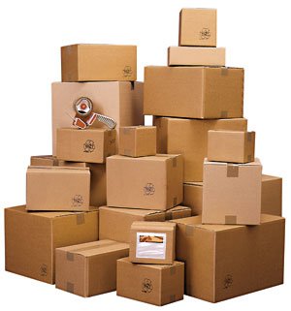
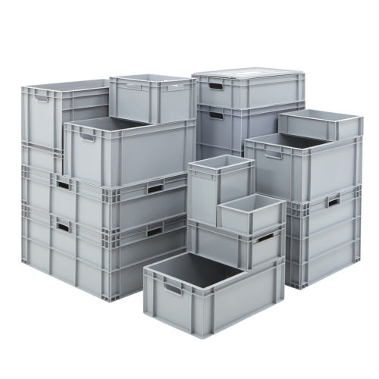
FMI: Simpler „Plumbing“ for Simulation
FMI for Model Exchange: How to connect systems of equations (ODEs)
FMI for Co-Simulation: How to connect “any” model or tool
Decouple Know-How between producers and users of FMUs
Decouple know-how between different brands engineers and software programmers
Massive Re-use of modelling investment
Many new use-cases are now viable
150+ tools now support FMI: See: fmi-standard.org/tools
https://fmi-standard.org/

Slide 20
Motivation for FMI 3.0
170+ tools support FMI now: many users now, many new use-case requests:
Virtual Electronic Control Units (vECUs):
FMI 2.0 works well for physics simulations: better support for vECUs is needed
Advanced Co-Simulation
Co-Simulation is the more popular interface type: improved co-simulation methods are needed to improve performance and accuracy
Multi-FMU simulations are getting more common
Events are necessary in complex control systems
Events must be synchronized across FMUs
New ML and AI applications
More derivatives computations is required
vECU
Co-Sim
Events
AI
API Efficiencies

Slide 21
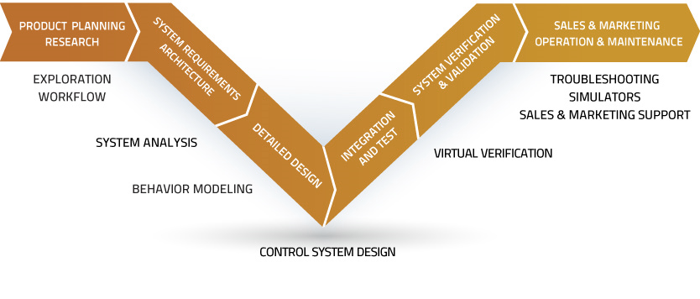
Models and model exchange along the “Design- Vee”
Requirements
Validated system
AI
Design
vECU
AI
Co-Sim
Co-Sim
Events
Events

Slide 22
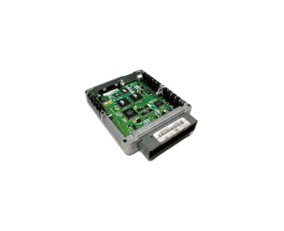
FMI 3.0: New Data Types
vECU
FMI 1.0, FMI 2.0 | FMI 3.0 | Remarks
fmiReal | fmi3Float32 | Discrete and continuous variables
 | fmi3Float64 | States, derivatives, event-indicators
fmiInteger | fmi3Int8, fmi3UInt8 | Discrete variables
 | fmi3Int16, fmi3UInt16
 | fmi3Int32, fmi3UInt32
 | fmi3Int64, fmi3UInt64
fmiBoolean | fmi3Boolean | char
fmiString | fmi3String | const char* ('\0' terminated, UTF-8 encoded)
 | fmi3Binary | const char* (e.g. sensor outputs, bitmaps, …)
 | fmi3Clock | Transport information about events
Notes:
Simple: these data types are used in real ECUs, having them in FMI enables realistic vECUs
Also: binary data for video, Lidar, radar, whever you want Modelica channel: tool demos

Slide 23
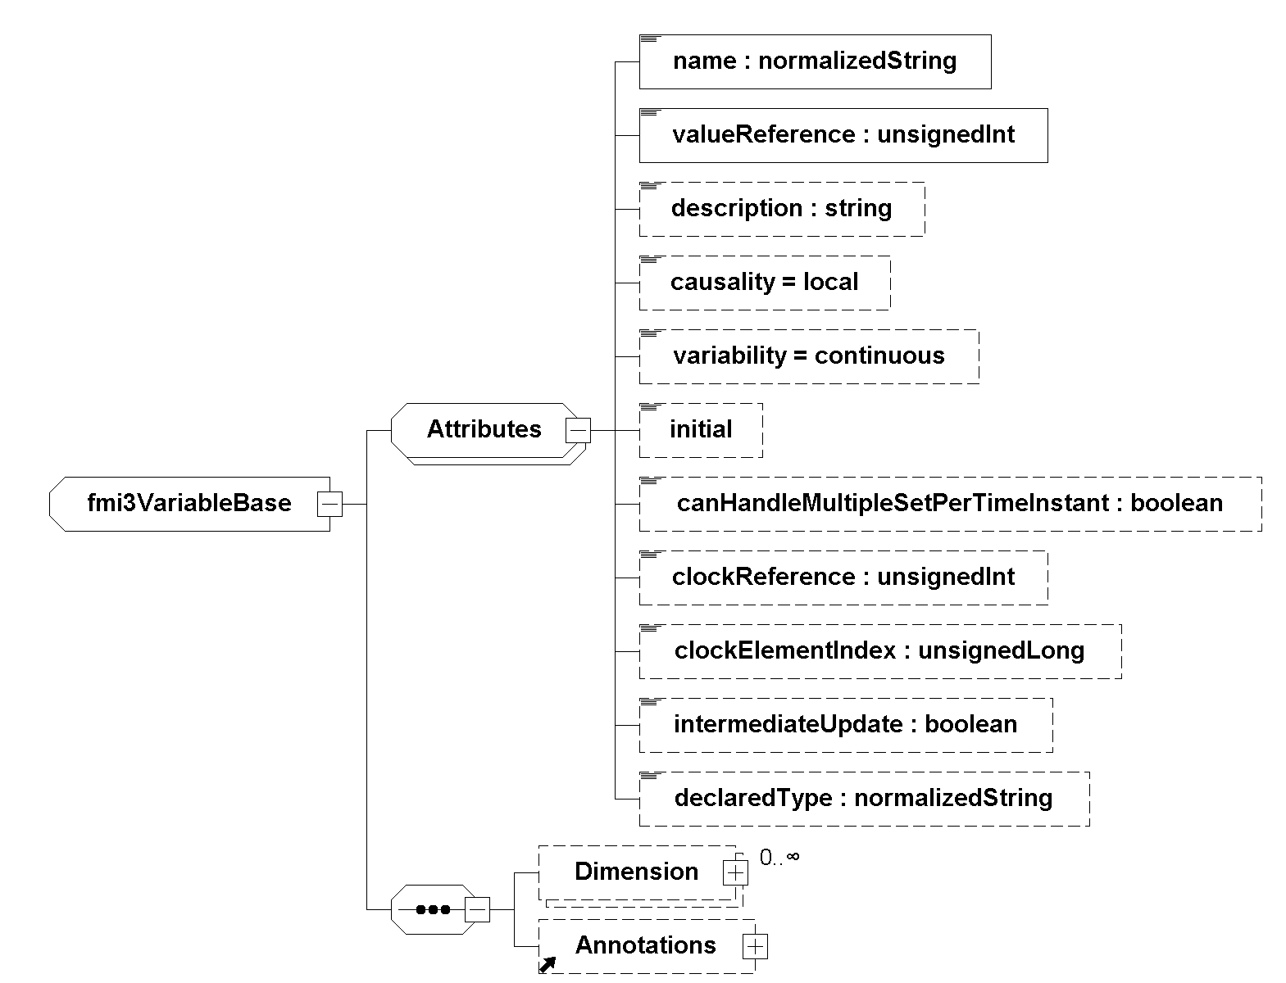
Array Variables (Vectors, Matrices, …)
vECU
FMI 1.0 and FMI 2.0:
Naming convention for array elements (building.room.temp[0], building.room.temp[1], …)
Array elements are treated as scalars, one valueReference for each variable
FMI 3.0:
Variables can have multiple <Dimension> elements
Each dimension can be:
Constant: specified by <start> attribute
Changeable: depends on a structural parameter which can change its value only in Configuration or Reconfiguration Mode
fmi3SetXXX, fmi3GetXXX work on whole arrays
API Efficiencies

Slide 24
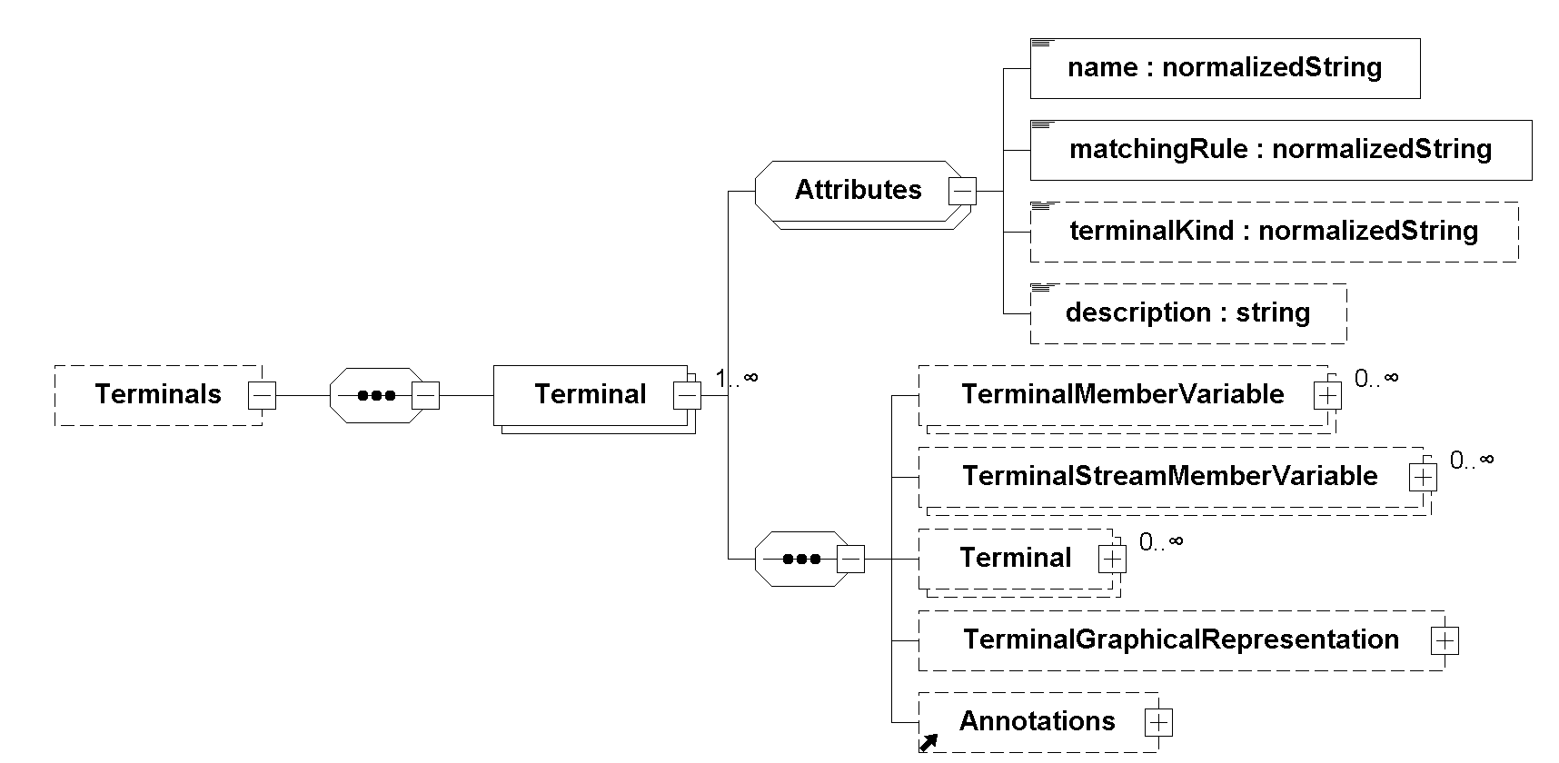
Terminals & Icons
Terminals group input and output variables to Terminals, which represent buses or physical connectors
Predefined matching rules (plug, bus, sequence) for the whole Terminal, other rules are possible
FMI Terminals are not acausal! The causality (input, output) is defined by the referenced variable!
Much improved UI: same structure & closer visual appearance to real system
Notes:
Use case: build UIs that reflect the structure of the physical system, or as in Modelica

Slide 25
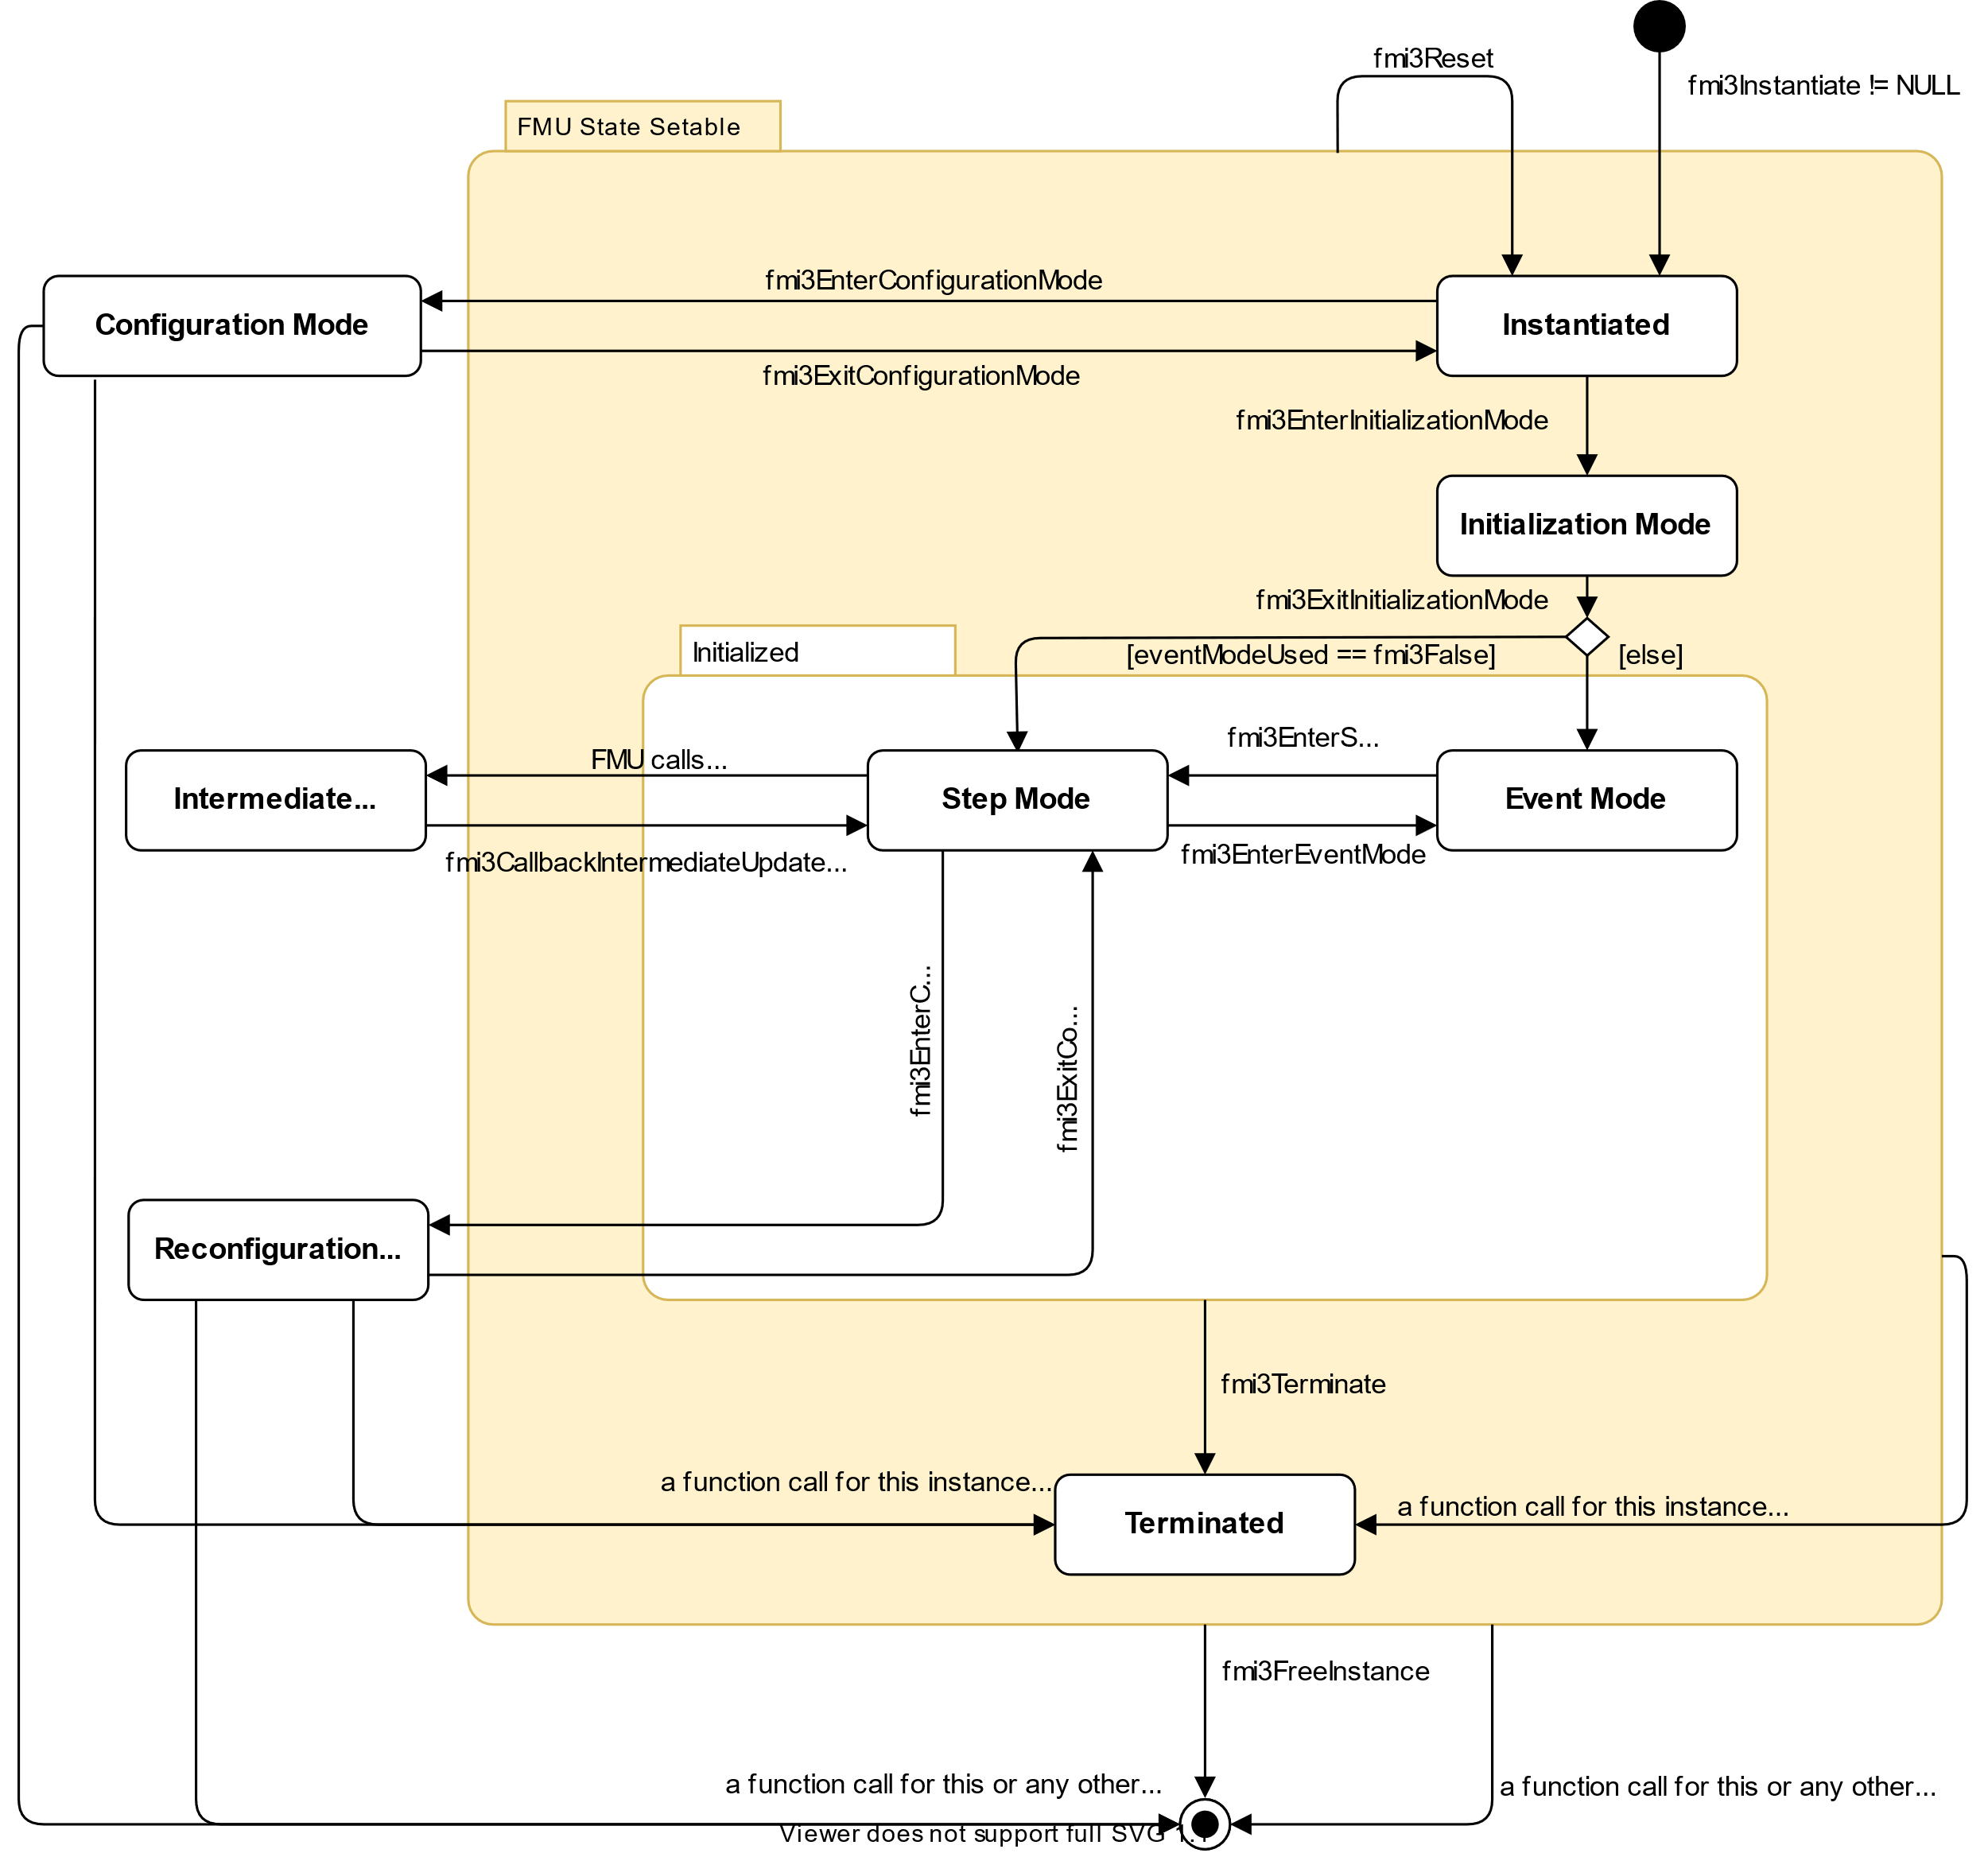
FMI for Co-Simulation: Event Handling
Co-Sim
Events
Introduction of Event Mode like in Model Exchange
Event Mode can be entered by the importer:
to handle input events triggered outside the FMU
on request of the FMU
fmi3DoStep(…) can return before communicationStepSize is reached if an FMU internal event needs to be treated outside
Capability flag hasEventMode signals if event handling is supported by the FMU
Argument eventModeUsed of fmi3InstantiateCoSimulation signals if event handling is supported by the importer
Demo in a Jupyter Notebook binder: Performance & Accuracy trade-offs, comparison FMI 2.0 vs. FMI 3.0

Slide 26
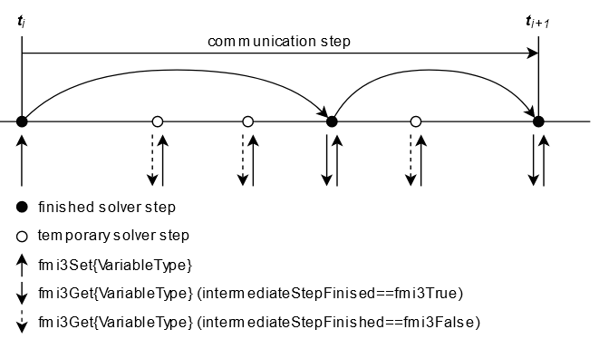
FMI for Co-Simulation: Intermediate Variable Access
Co-Sim
FMI1/2 CS: FMUs exchange values only at communication points.
FMI3.0: allows information exchange between the FMU and the master also at intermediate time points
Realized with an extension to the state machine: Intermediate update mode which can be entered by the FMU via the callback function fmi3CallbackIntermediateUpdate(…) at arbitrary times out of fmi3DoStep(…)
This enables various use cases:
Advanced co-simulation algorithms using interpolation / extrapolation techniques
Transmission Line Modeling (TLM) co-simulation
Input approximation similar to what is possible in FMI 2.0
More detailed plotting of simulation results (using additional time point)
Demo in a Jupyter Notebook binder: Performance & Accuracy trade-offs, comparison FMI 2.0 vs. FMI 3.0

Slide 27
Clocks
vECU
Co-Sim
Events
Clocks synchronize FMUs with the importer and with other FMUs:
Clocks carry the information that a specific event happens
Clocked variables belong to one clock (a so-called clocked model partition). They change only if this clock is active.
Clocks allow precise handling of time events (independent from continuous time: fmi3SetTime(), or arguments of fmi3DoStep())
In Scheduled Execution Communication Clocks are used:
by the importer to identify the specific partition which is to be executed
by the FMU to announce, which model partition wants to be scheduled

Slide 28
Clock Types
vECU
Co-Sim
Clock Type |  | causality | interval | Example
Time-based | periodic clock | input | constant | Clocked PI-controller with a defined constant interval
 |  |  | fixed | Clocked PI-controller, interval is defined by periodic fmi3SetClock calls
 |  |  | calculated | Clocked PI-controller, interval is defined by fixed parameter(s) of the FMU
 |  |  | tunable | Clocked PI-controller, interval is defined by tuneable parameter(s) of the FMU
 | aperiodic clock | input | changing | Simulation of the behaviour of a control algorithm with non constant execution time, Generation of pulse sequences
 |  |  | countdown | Time delayed action after an event, for example ignition signal some time after crankshaft angle event
Triggered |  | input | triggered | Control algorithm, triggered by a crankshaft angle sensor
 |  | output | triggered | Crankshaft angle sensor which ticks several times per revolution
Events

Slide 29
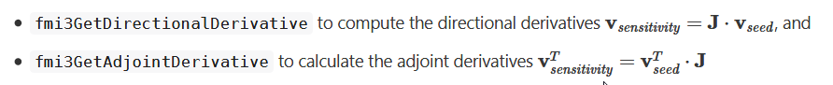
Adjoint Derivatives
AI
In several applications, including backpropagation for gradient-based training AI models, adjoint derivatives (“vector gradient products" (VJPs)) are needed
They can be implemented efficiently using revers mode automatic differentiation (AD)
FMI 3.0 provides now two access functions for partial derivatives:
Benefit:
This will allow to more efficiently encapsulate and train AI models with FMI
Connection of the Python/Julia tool world of AI to the system simulation world
Enabling the combination of physics-based and AI-based models (e.g. neural ODEs) and training in a unified framework

Slide 30
Concept of Layered Standard
vECU
The layered standard concept allows the specification of standards on top of FMI
XML element annotations and strings allow additional semantic for variables and terminals
Extra folder in FMU zip-file allows shipping of additional files at a well-defined place without disturbing compatibility
Examples:
XCP: When packaging virtual electronic control units (vECUs), XCP allows standardized access (see ASAM) to ECU internal variables (in preparation on FMI GitHub)
Network2Signals: Allows grouping and description of FMU inputs and outputs as network signals (in preparation on FMI GitHub)
Including of 3D-Visualization to FMUs which represent multi body simulation models (prototype from ESI ITI and TU Dresden)
Notes:
Demo available. Not necessarily important to show.

Slide 31
Miscellaneous
Graphical representations for the whole FMU and for Terminals can be defined (Icons)
Alias variable names are now specified by a list of alias names for each variable and no longer by a separate variable with the same valueReference.
Dependencies might change at runtime due to variable structure of the model or due to changes of array sizes. Dependencies for (array) variables can now be retrieved at runtime.
Asynchronous execution of fmi2DoStep was removed for simplification. This feature was never used and can be implemented by the importer.
Improvement and clarification of source code FMUs for better platform independency.

Slide 32
Roadmap & Resources
FMI 3.0 has been published in May 2022. Due to continuous tool development and testing of prototypes, the quality of the standard is much higher than for standards where the definition and the prototyping are decoupled!
Currently the development focuses on
The implementers guide for FMI 3.0, nearly finished: https://modelica.github.io/fmi-guides/main/fmi-guide/
And on “Layered Standards” on top of the final FMI 3.0 specification
“Backporting” of some of the FMI 3.0 features to FMI 2.X as layered standards
Resources:
Main website: https://fmi-standard.org/
Development process can be tracked on GitHub: https://github.com/modelica/fmi-standard
FMI Layered Standards: https://github.com/modelica/fmi-ls-xcp; https://github.com/modelica/fmi-ls-bus
FMPy is permanently updated to support FMI 3.0: https://github.com/CATIA-Systems/FMPy
Reference FMUs: https://github.com/modelica/Reference-FMUs

Slide 33
More information
Web site: https://fmi-standard.org
Tool list: https://fmi-standard.org/tools/
Ask your tool vendors!
Publications: https://fmi-standard.org/literature/
Open-source tool kits:
Many more use cases:
FMUSDK: example FMUs and simple importer
FMU Checker: validate your FMUs
Reference FMUs: more example FMUs
FMPy: Python integration

